Slide 1
Cool things with Norwegian National road data base (NVDB)
Jan Kristian Jensen
jan.kristian.jensen@vegvesen.no
@LtGlahn
@nvdbapi

Slide 2
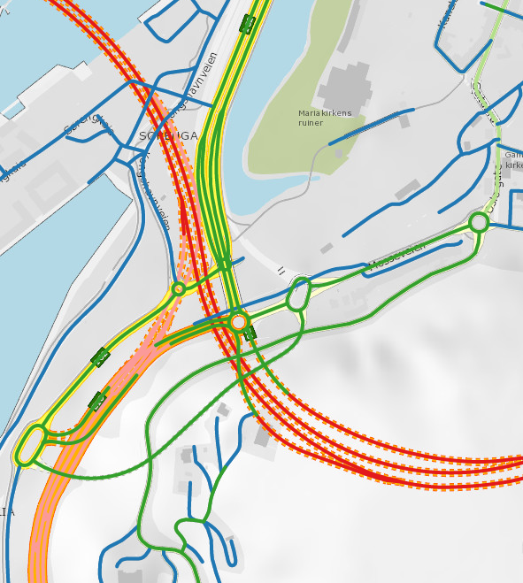

NVDB
All roads > 50m (for motor vehicles)
253.000 km
Primary source for road network data, navigation +++

Slide 3
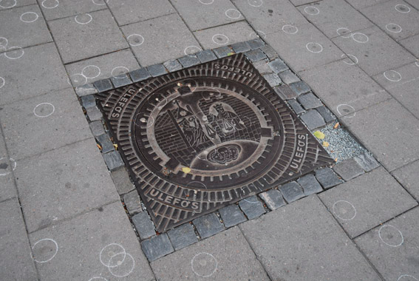

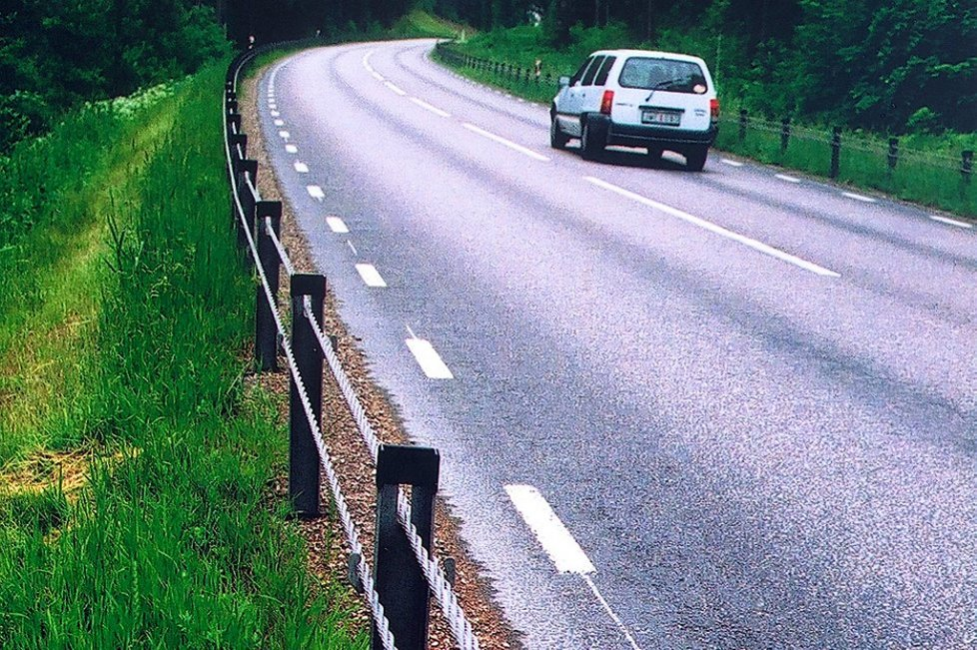


Inventory – physical equipment
348 270
Data coverage:
Mainly along major roads
E, R, F categories (Our responsibility)
Communal roads
more spotty
191.000 km.
1547
169 527
19 900 km

Slide 4
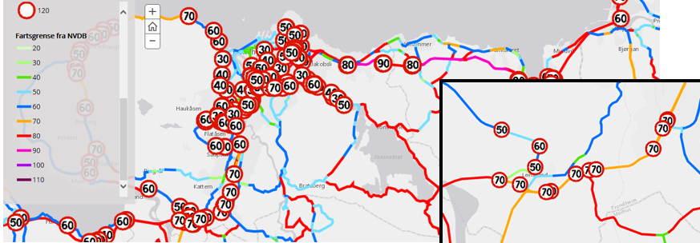
Administrative + statistics
Who maintains the road?
How important is it?
Regulations
Traffic accidents
How much traffic?

Slide 5
Topopogical road network 385 data types, defined in data catalogue

Slide 6
NVDB – data served in: Different services Different flavors Different formats

Slide 7


Slide 8
Navigation?
Are you interested in…?
Optimum route?
Travel distance / time?
Topological data
Road network analysis

Slide 9

Navigation?
Are you interested in…?
Pre-made navigation data
- ELVEG
- Route planner data set
Optimum route?
Travel distance / time?
Topological data
Road network analysis
https://kartkatalog.geonorge.no/search?text=elveg
Official road data + adresses. Sosi format.
https://www.vegdata.no/2013/08/08/hvor-finner-jeg-vegnettsdata-til-navigasjon/
.gdb, sqlite format => used with pgrouting

Slide 10




Elveg – road network for navigasjon
Official product
Versjoned, 10 times each year
File based, SOSI format
Road network with restrictions
Selected NVDB data (speed limits m.m.)
Adresses
Road names
Sosi
More info:
https://www.vegdata.no/2014/08/15/vegdata-for-navigasjon/

Slide 11
Cant read SOSI???
SOSI =Ascii text format, Norwegian standard, from 1987
Vegvesen route planning application API
Used in http://vegvesen.no/trafikk
http://data.norge.no/data/statens-vegvesen/api-ruteplantjeneste-bil
Open data policy: What we use => we publish!
https://www.vegdata.no/2013/08/08/hvor-finner-jeg-vegnettsdata-til-navigasjon/
.gdb and spatialLite – format
Produced in parallell with Elveg (x10/year)

Slide 12
Navigation?
Are you interested in…?
Pre-made navigation data
ELVEG
Route planner data set
Optimum route?
Travel distance / time?
Topological data
Road network analysis
Route planner API
http://data.norge.no/data/statens-vegvesen/api-ruteplantjeneste-bil
REST api for A => B navigation, up to 8 wp’ts. (via-points).
JSON, XML

Slide 13
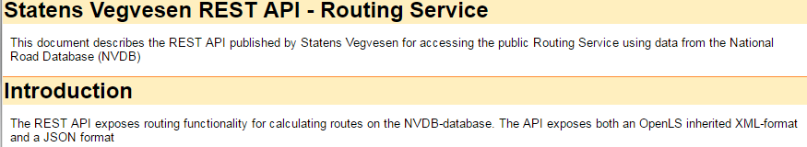
Route planner API
Open API, but you need an account…
2500 req/day.
http://data.norge.no/data/statens-vegvesen/api-ruteplantjeneste-bil
Good examples in the documentation –straigthforward REST API
Basic http auth, not very JS / CORS – friendly

Slide 14
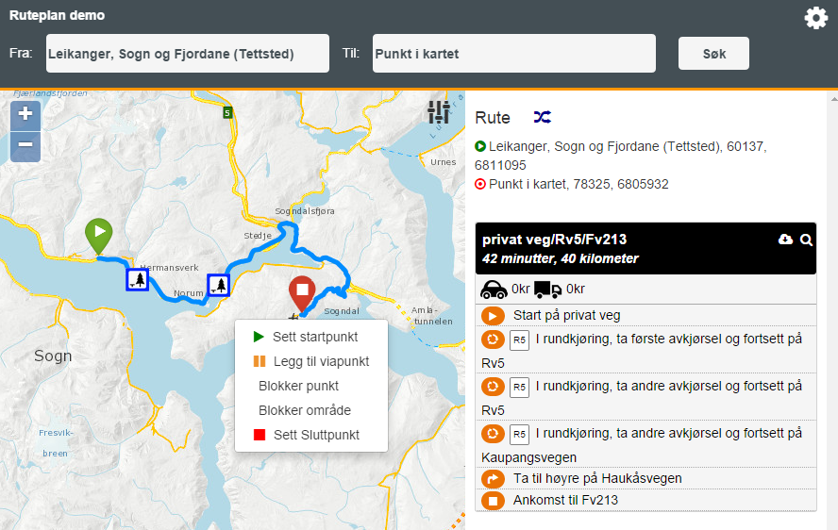
Test/demo client, Route planner API
http://svvruteplan.azurewebsites.net/#/

Slide 15
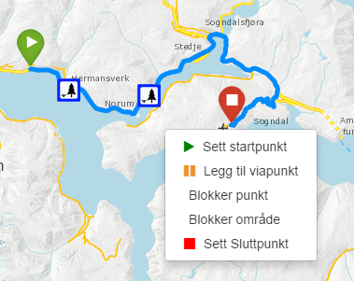
Test/demo client, Route planner API
https://github.com/petlof/svv-ruteplan-demo
More information:
https://www.vegdata.no/2014/09/18/vegvesenets-forste-apen-kildekode-prosjekt/
«Code dump», not really FOSS…

Slide 16
Navigation?
Are you interested in…?
Pre-made navigation data
ELVEG
Route planner data set
Optimum route?
Travel distance / time?
Topological data
Road network analysis
Route planner API
NVDB API/vegnett
Topological network
https://www.vegvesen.no/nvdb/apidokumentasjon/#/get/vegnett

Slide 17
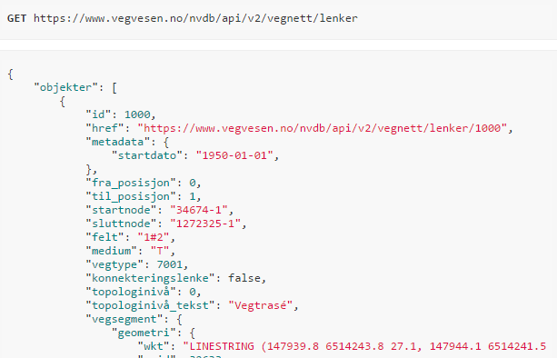
NVDB api - Topological network
https://www.vegvesen.no/nvdb/apidokumentasjon/#/get/vegnett
Only the links – but nodes are referenced
Enough to reverse-engineer topology
No turn restrictions etc => not suitable for navigation

Slide 18
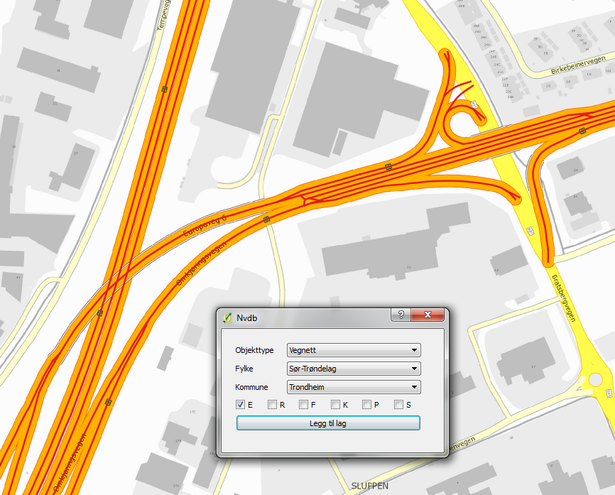
QGIS prototype - road network plugin
https://github.com/nvdb-vegdata/nvdb-qgis
Buggy & experimental
Old QGIS version
Must upgrade to V2 of api (soon)

Slide 19
Navigation? Road network data?
Are you interested in…?
Optimum route?
Travel distance / time?
Topological data
Road network analysis
Pre-made navigation data
ELVEG
Route planner data set
Route planner API
Rest API
A=>via C => B
NVDB API/vegnett
Topological network

Slide 20
Navigation? Everything else!
Are you interested in…?
385 object types
NVDB api is excellent!
https://www.vegvesen.no/nvdb/apidokumentasjon/
Get friends with NVDB using Vegkart
http://vegkart.no

Slide 21
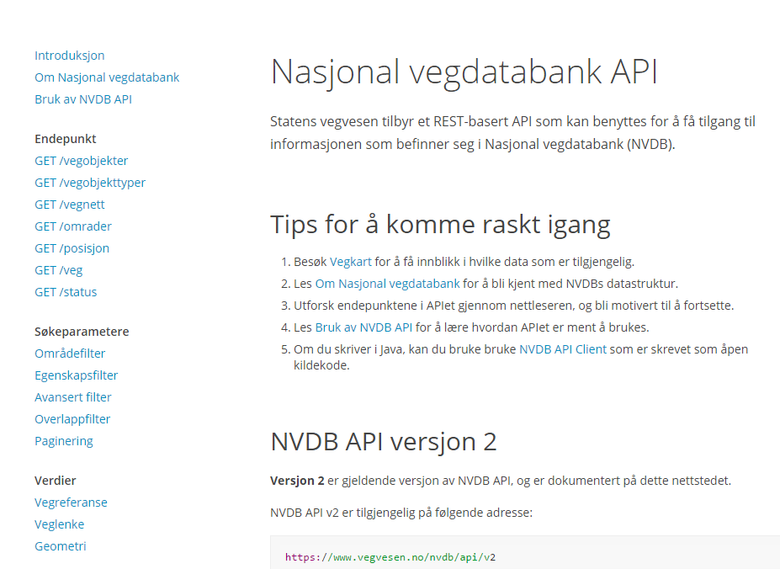
V2 of NVDB api
https://www.vegvesen.no/nvdb/apidokumentasjon/

Slide 22
V2 of NVDB api
https://www.vegvesen.no/nvdb/apidokumentasjon/
Developer friendly
More REST-full
Powerful filters
More intiutive
- object type definiton ⬄ Data queries
- Filtering
Versioning / change log (changes after…)
Easy-to-use pagination

Slide 23
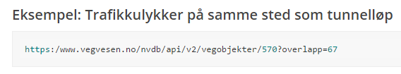
Overlap filter
https://www.vegvesen.no/nvdb/apidokumentasjon/#/parameter/overlappfilter
traffic accidents
within
tunnels

Slide 24
More filter!
traffic accidents
where someone died
https://www.vegvesen.no/nvdb/api/v2/vegobjekter/570?egenskap="5074=6427"&overlapp=105(2021=2738)
and speed limit = 80 km/h
Data catalogue definitions
https://www.vegvesen.no/nvdb/apidokumentasjon/#/get/vegobjekttyper

Slide 25
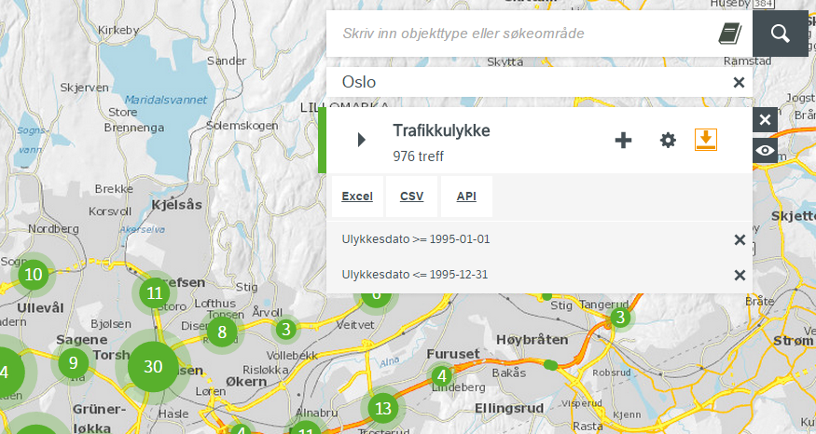
Vegkart http://vegkart.no is your friend!
Caveat: Vegkart reads V1 of NVDB api (per aug-2016)
http://www.vegdata.no/2015/10/16/na-er-det-enda-enklere-a-lage-sok-mot-nvdb-api/

Slide 26
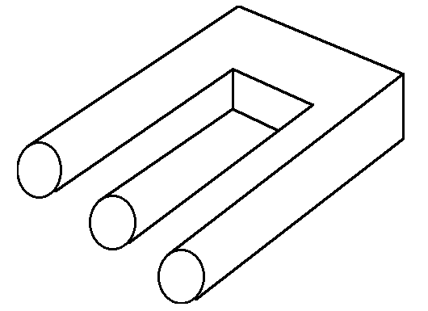
Pitfalls & headaches
Why is NVDB so insanely difficult?

Slide 27
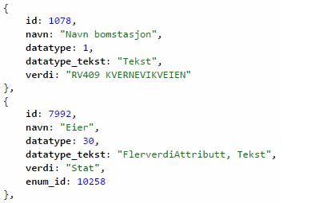
Gis-unfriendly data model
Why is NVDB so insanely difficult?
Property | Value
Navn bomstasjon | RV409 KVERNEVIKVEIEN
Eier | Stat

Slide 28
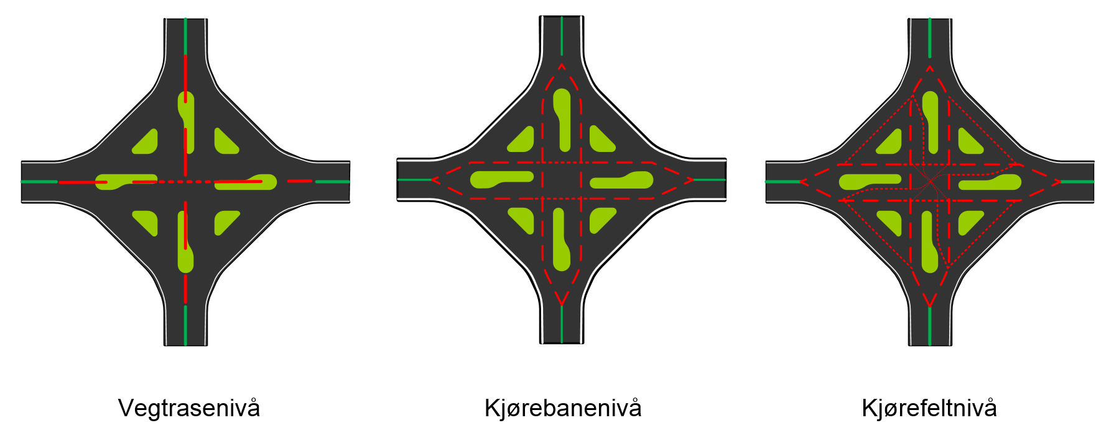
Topology levels
Why is NVDB so insanely difficult?
Road network = 1, 2 or 3 topology levels where needed

Slide 29


Topology levels
Why is NVDB so insanely difficult?
Data are almost always at uppermost level
Mapping to other levels as needed…
Kjørebane
Vegtrasé
Kjørebane

Slide 30
Topology levels
Why is NVDB so insanely difficult?
Data mapped between topology levels
=> all sort of confusion
Kjørebane
Vegtrasé
NVDB api
Kjørebane

Slide 31
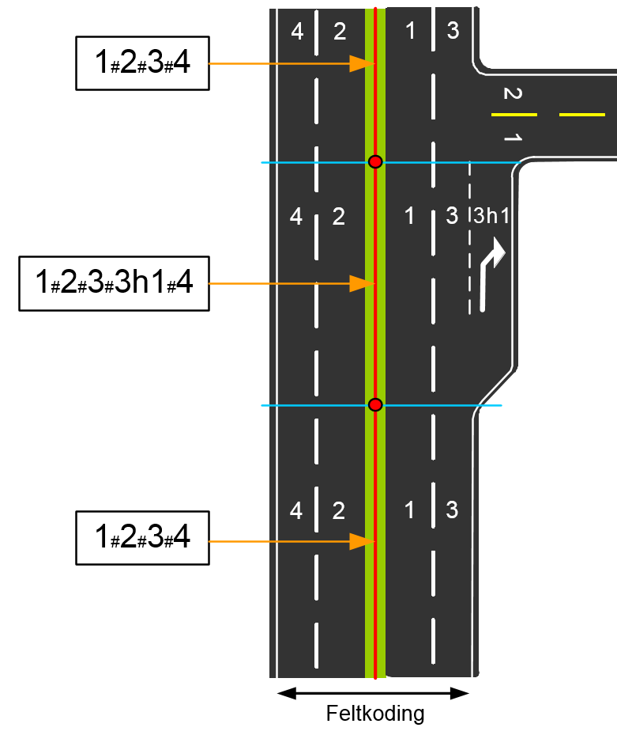
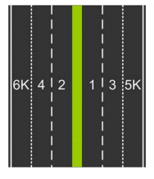
Lane definition, oh my
Why is NVDB so insanely difficult?
1#2#3#4#5K#6K
Object type 616 Feltstrekning https://www.vegvesen.no/nvdb/api/datakatalog/objekttyper/616
Notes:
Data are (almost always) at the uppermost level
If not, data are mapped lower => uppermost level at NVDB api

Slide 32


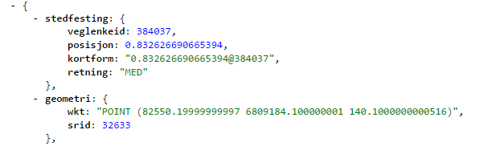

Linear references? Drives me nuts…
Why is NVDB so insanely difficult?
Lineare references
Non-dimensional [0..1]
Metering system
Coordinates
Rekkverk
Stikkrenne
Fartsgrense
Feltstrekning
Vegens referanselenke

Slide 33
GIS-friendly = homogenous segments
Why is NVDB so insanely difficult?
Speed limit
Road class
70km/h
BK1

Slide 34
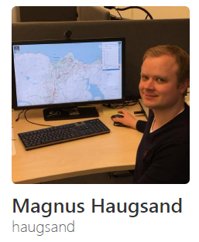


Repositories
https://github.com/haugsand/
Not maintained, will become stale (V1 NVDB api)
Javascript, python
https://github.com/nvdb-vegdata
Java: reading (NVDB api V2) and writing to NVDB
Javascript & python: Mostly V1
«Official» repos
https://github.com/ltglahn
My own playground
Python NVDB api V2 (first version)
FME (proprietary tool, $$)

Slide 35

Writing to NVDB? Try the docker mock-up
Mock-up NVDB api server under your control
Same login
Same strict data validation (format, consistency ++)
Same everything, exept you don’t actually write to NVDB
Good documentation
https://www.vegdata.no/2016/03/09/utviklerutgave-av-skrive-apiet-tilgjengelig-pa-docker-hub/

Slide 36
Come to our developer conference!
23. sept 2016, Trondheim
https://www.vegdata.no/2016/08/24/nvdb-apne-vegdata-utviklerkonferanse-2016/

Slide 37

Thank you!
© julehuset.no

